Slide 1

Zomato Dataset Analysis
Omar Ashraf Darwish

Slide 2
Agenda
Interpretation of Business Questions.
Interpretation of The Evaluation of The Machine Learning Model.
Summary of The Results and how to make use of it.

Slide 3
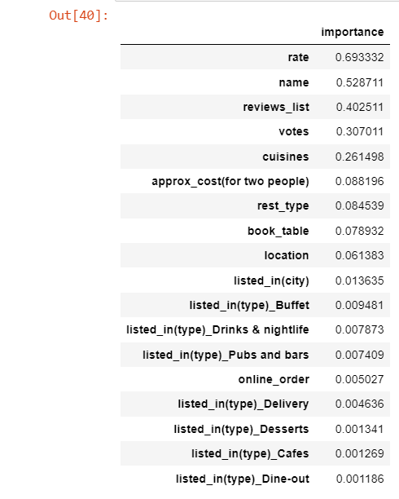
Interpretation of The Business Questions
What are The Main Factors that would make The Restaurant a Target for Customers ?
By analyzing The Features and Sorting Them based on Importance and Effect on The Restaurant being a Target of Customers we found that The Rating of The Customer affects it with around 70%, The Name with around 53% and The Reviews List with 40% effect.

Slide 4
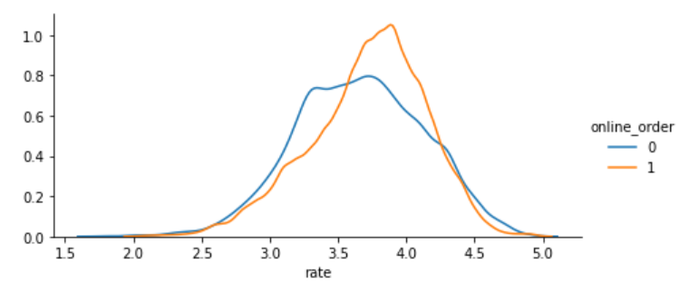
Interpretation of The Business Questions
Does Online Service affect Rating ?
From The Dataset and by visualizing The Relationship between them using Facet Grid, We found that Restaurants with rating higher than 3.6 have Online Services Which ensures the relationship between them.

Slide 5
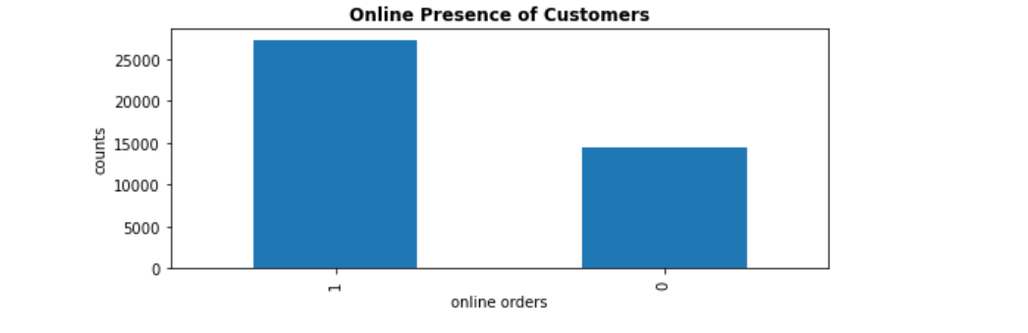
Interpretation of The Business Questions
Is Online Service widespread in The Areas ?
From The Dataset and By using Bar Graph we found that more than 25000 Restaurants have Online Ordering Service while around 15000 doesn’t have Online Service.

Slide 6
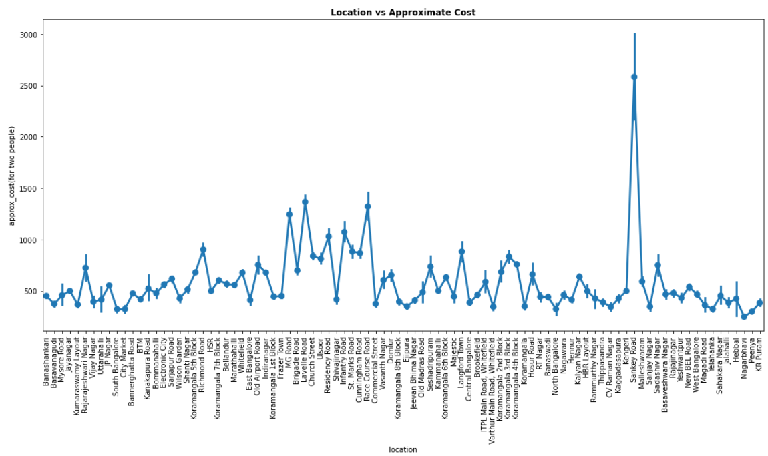
Interpretation of The Business Questions
Does The Location affect The Approximate Price ?
From The Dataset and By using Point Plot we found that some Locations such as Sankey Road have an approximate cost of more than 2500 Rupee and Lavelle Road have of around 1500 Rupee.
They have a weak correlation of 0.268
So, we conclude that The Location is affecting The Approximate Price weakly.

Slide 7
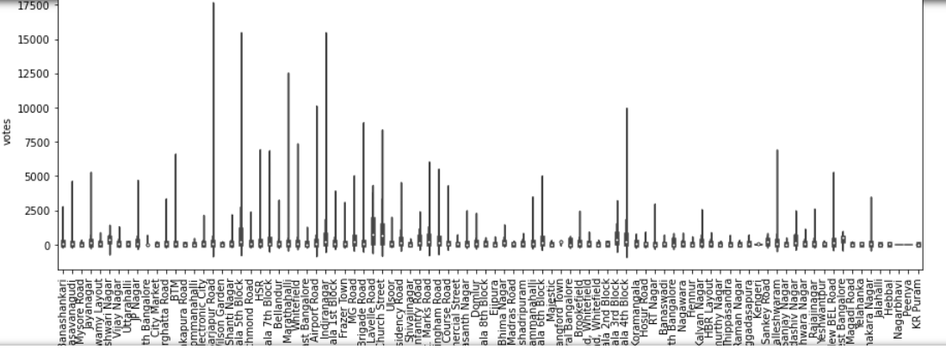
Interpretation of The Business Questions
Does The Location of The Restaurant affect The Number of Votes ?
From The Dataset and By using Violin Plot we found That Some Locations have a Very Large Number of Votes such as Sarjapur Road and Others have very Low Number of Votes such as Utarahalli.
So, We conclude That the Location is affecting The Number Of Votes for The Restaurant.

Slide 8
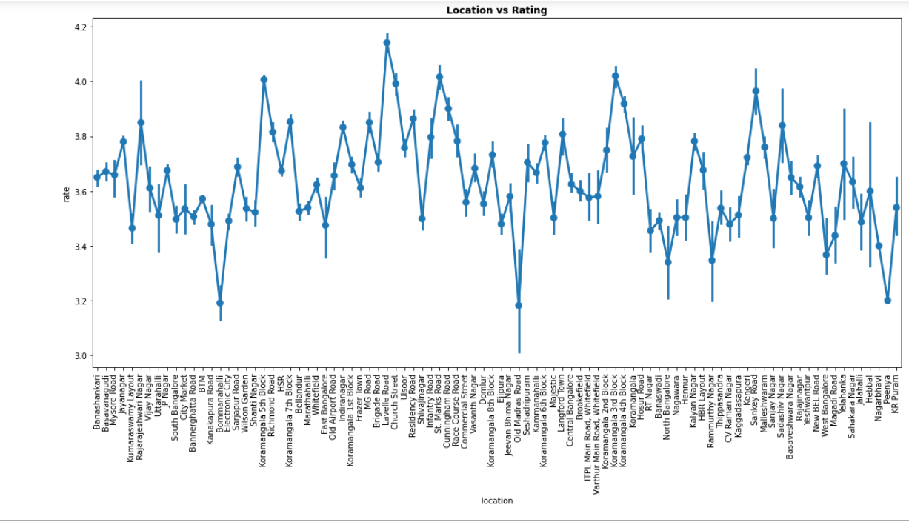
Interpretation of The Business Questions
Which Locations have The Highest Rating ?
From The Dataset, and By using Point plot we found that the rating varies with The Locations.
Some Locations such as Ulsoor have The Highest Rating while Boomanhalli have the lowest rating.

Slide 9
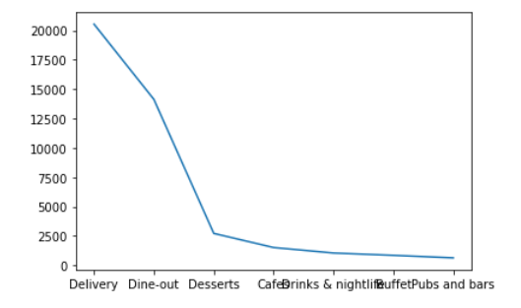
Interpretation of The Business Questions
What are The Most Widespread Type of The Restaurants ?
By Analyzing The Types of The Restaurants, We found that Delivery Restaurants are The Most widespread while pubs and Bars are The Least Spread.

Slide 10
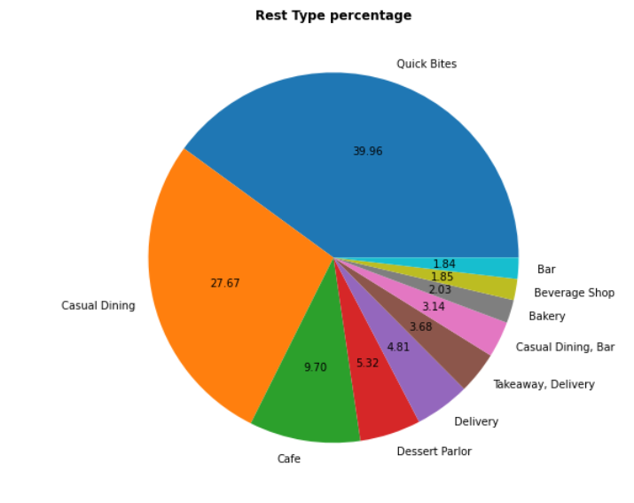
Interpretation of The Business Questions
What are The Most Widespread Rest Types in The Areas ?
By analyzing The Dataset and By using Pie Chart, We found that around 39.9 % of The Restaurants are Quick Bites, Secondly there are Casual Dining with 27.67% while Bars are The Least Widespread with around 1.84%.

Slide 11
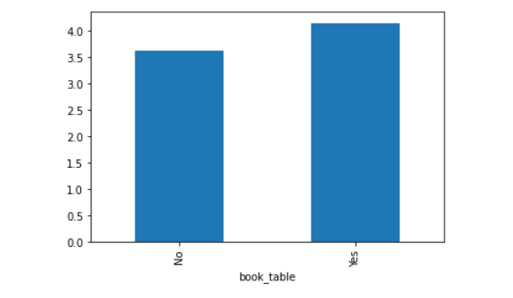
Interpretation of The Business Questions
Does Table Booking Service affect The Rating ?
By Analyzing and Visualizing The Two Features we found that The Restaurants with Table Booking Service have a rating around 4.2/5 while The Ones with No Table Booking Service have 3.7/5.
So, We found that The Table Booking Service influence The Rating.

Slide 12
Interpretation of Machine Learning Evaluation
In This We used Three Different Algorithms to create The Machine Learning Models
The First Algorithm : The Random Forest Algorithm
Training Score : 100%
Testing Score : 100%
Precision : 100%
Recall : 100%

Slide 13
Interpretation of Machine Learning Evaluation
In The First Algorithm we used Hyperparameter tuning using Randomized Search CV Method and The Results were :
Score : 100%
MSE : 0%
RMSE : 0%
Precision : 100%
Recall : 100%

Slide 14
Interpretation of Machine Learning Evaluation
The Importance of Hyperparameter Tuning :
Hyperparameter Tuning is an essential part of The Machine Learning Process, It helps controlling the behavior of The Training Algorithm.
It has a Significant Impact on The Performance of The Model which is being trained.
In Randomized Search CV, It randomly samples the search space and evaluates sets from a specified probability distribution.

Slide 15
Interpretation of Machine Learning Evaluation
The Second Algorithm we used Decision Trees Algorithm and The Results were :
Score : 100%
MSE : 0%
RMSE : 0%
Precision : 100%
Recall : 100%

Slide 16
Interpretation of Machine Learning Evaluation
The Third Algorithm we used XG Boost and The Results were :
Score : 100%
MSE : 0%
RMSE : 0%
Precision : 100%
Recall : 100%

Slide 17
Interpretation of Machine Learning Evaluation
Validation of The Machine Learning Model :
The Validation of The Model is to ensure The Accuracy and Performance ( to perform well on The unseen Data).
By Splitting The Data into 80% for Training and 20% for Testing and By Training The Model on 80% of The Data and Testing it on The rest of The Data and Applying The Machine Learning Algorithms on it.

Slide 18
Summary of The Results and How to make use of It
Based on The Analysis performed we have reached that :
Based on that 39,96% of The Restaurants, We conclude that Bangalorians consume a lot of Fast Food.
Providing Online Ordering can provide higher chances of being a Target to Customers.
We found that Locations such as Ulsoor, Koramangala 2nd Block and 3rd Block may increase The Rating of The Restaurant, therefore , increase The Chance of being a Target.

Slide 19
Summary of The Results and How to make use of It
How to make use of It :
We can advise The Newly Opening Restaurants to :
To Open in Places such as Ulsoor, Koramangala 2nd Block and 3rd Block
To Provide Services such as Table Booking and Online Ordering
Try to get Many Votes For The Restaurants.
Try to get High Ratings for The Restaurants.

